Slide 1

WEB BASED MEETING CALL SCHEDULER SYSTEM
Developed By:
Md Mostafizur Rahman
CCSL , J2EE
Round :37
Supervised By :
Mohammad Rajaul Islam

Slide 2
Developed By:
Md Mostafizur Rahman
CCSL , J2EE
Round :37
Instructor By :
Mohammad Rajaul Islam

Slide 3
Web Based Meeting Call Scheduler- System Requirement Specifications
Requirement:
1 . Introduction
The Web Based Meeting Scheduler Is Aimed At Developing An Application To Schedule, Monitor, Plan
And Re-plan Meetings To Help Md Rezaul Islam Sir. In Accelerating Their Business By Scheduling Their Meetings
Sooner And Faster. It Eliminates Email And Phone Tag, And Ensures A Satisfying Scheduling Experience
For All Attendees.

Slide 4
2. Purpose
The purpose of this document is to present a detailed description of the Web Meeting Scheduler
System.Error! Bookmark not defined. This document explains the purpose and features of the
system and the constraints under which it must operate.
3. Project Overview
The web based meeting scheduler (WMS) is a user friendly tool developed to assists humans in office
environments to schedule meetings efficiently. The policies used in the web based meeting scheduler
paves way for negotiation of various processes on behalf of their users and comes up with an
agreement on a common meeting time that is acceptable to all the users and abides by all the
constraints set by the hosts and attendees. In summary the Web-based Meeting

Slide 5
Scheduler follows a
decision oriented methodology that depends on knowledge based approach. The purpose of WMS is to
support the organization of meetings and to determine for each meeting request, a meeting date and
location so that most of the intended participants shall effectively participate
The key functionalities of this system are:
• Schedule/ plan meetings
• Monitor meetings, especially held in a distributed environment
• Re-planning of meetings to support changing user constraints
• Support conflict resolution
• Keep participants informed of the meeting schedules and any changes

Slide 6
4. Project Usability
• Automate the meeting schedule process to enable efficient use of the time and efforts of meeting organizer.
• Select a date and time according to the availability of the participants.
• Allocate the location that is convenient to all the participants.
• Send re minders to the participants about the meeting and any schedule changes.
• Reorganize and modify the meeting schedule if required.
5. Product Functions
Using this application one can do the following major functions:
• Set up meetings.
• Monitor meetings which are especially held in a distributed manner or periodically.
• Re-plan meetings.
• Cancel meetings.
• Send SMS notifications.

Slide 7
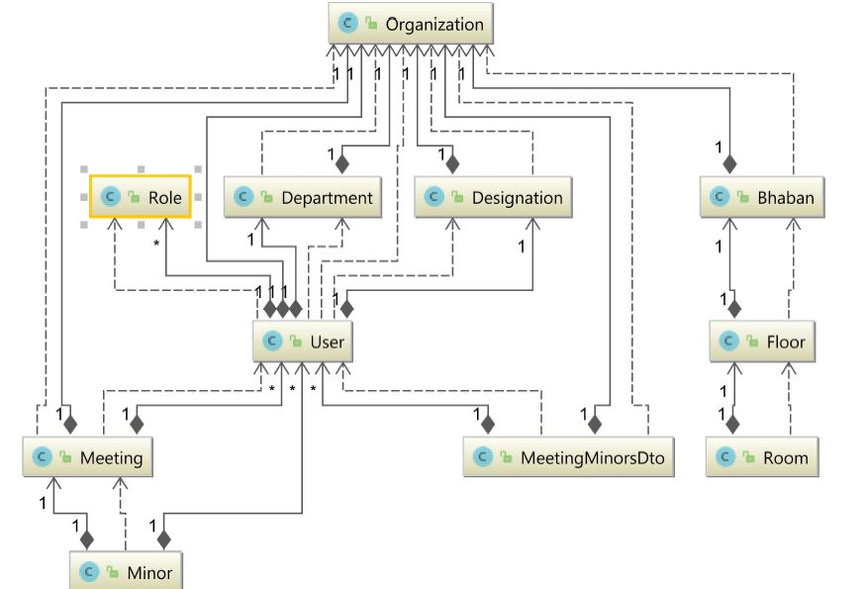
Entity Relationship Diagram (ERD)

Slide 8
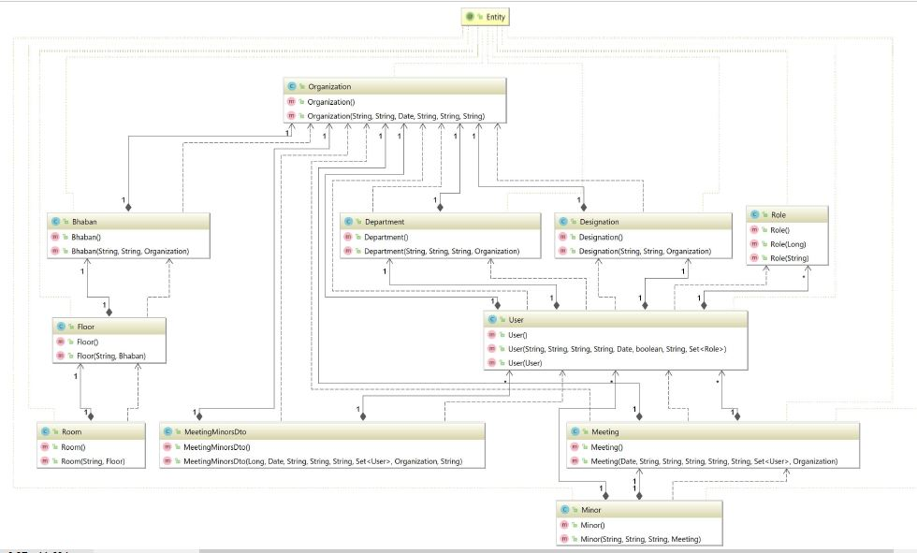
Entity Method

Slide 9
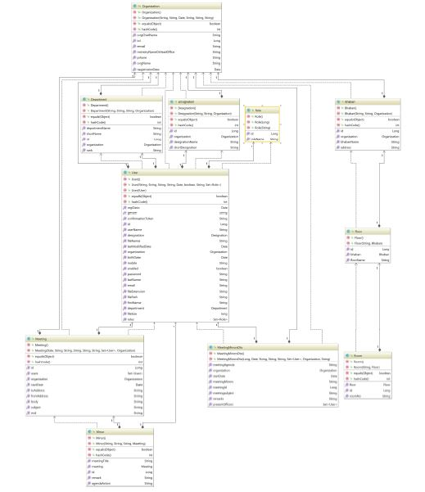
Entity Class Diagram (ECD)

Slide 10
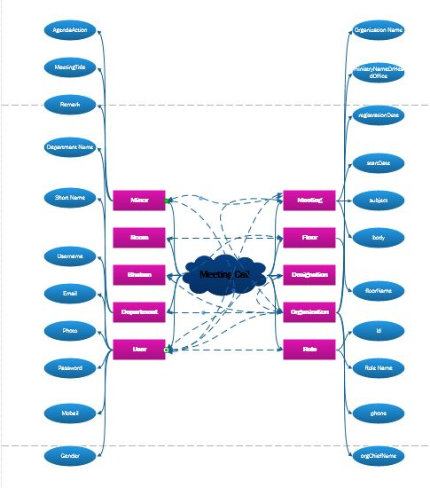
Brainstorming Diagram

Slide 11
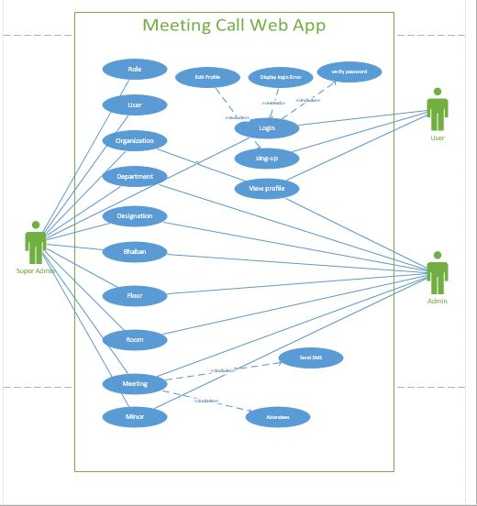
Use Case Diagram

Slide 12
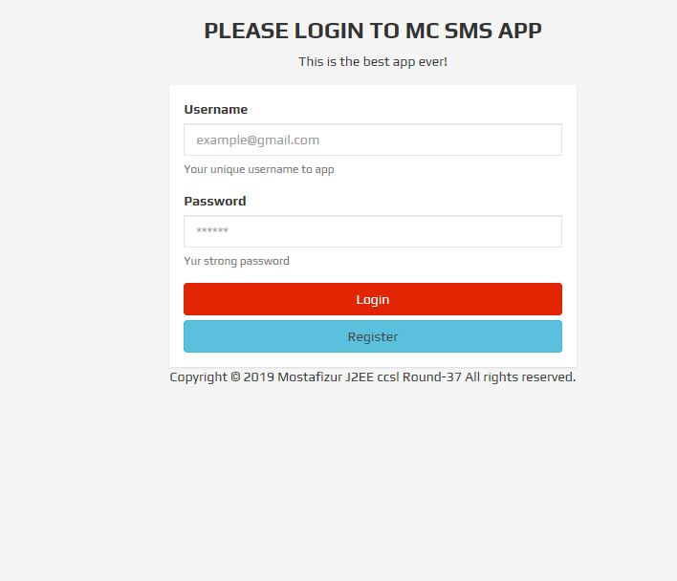
Login

Slide 13
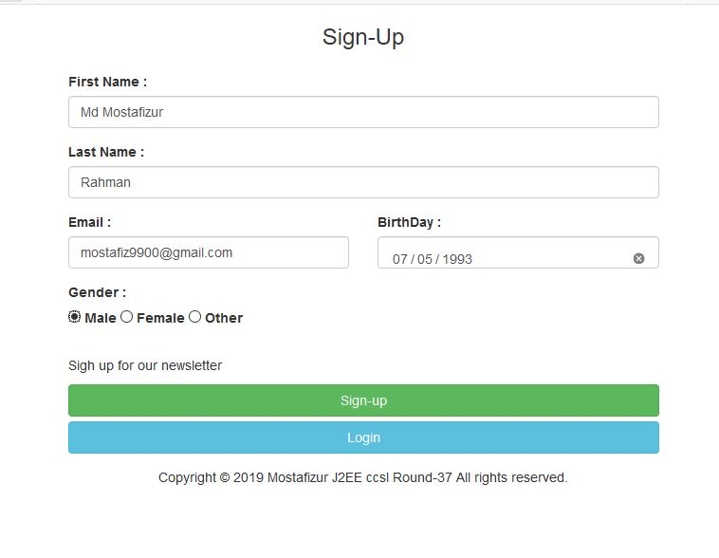

Slide 14
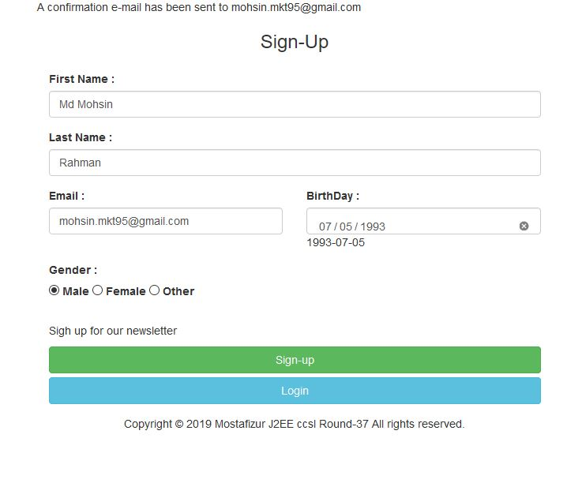
Sign Up Successfully

Slide 15
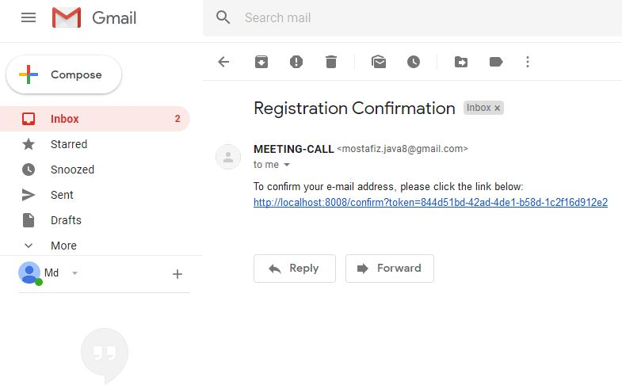
Email Link Send

Slide 16
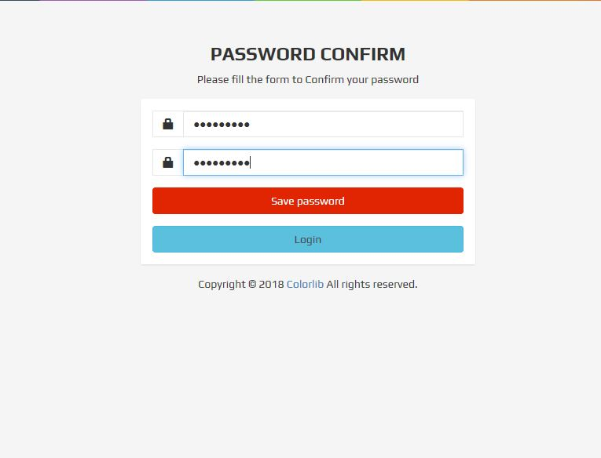

Slide 17
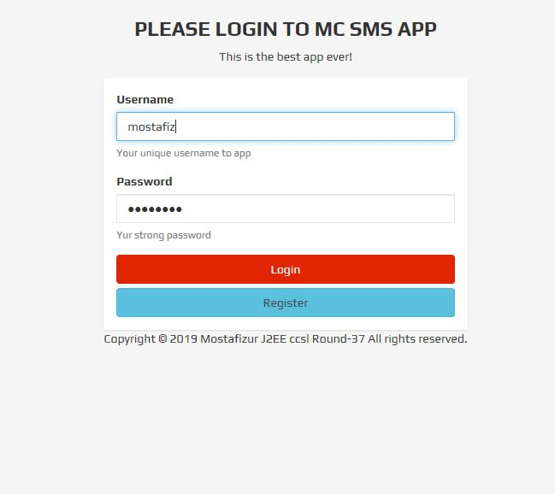
Login Success

Slide 18
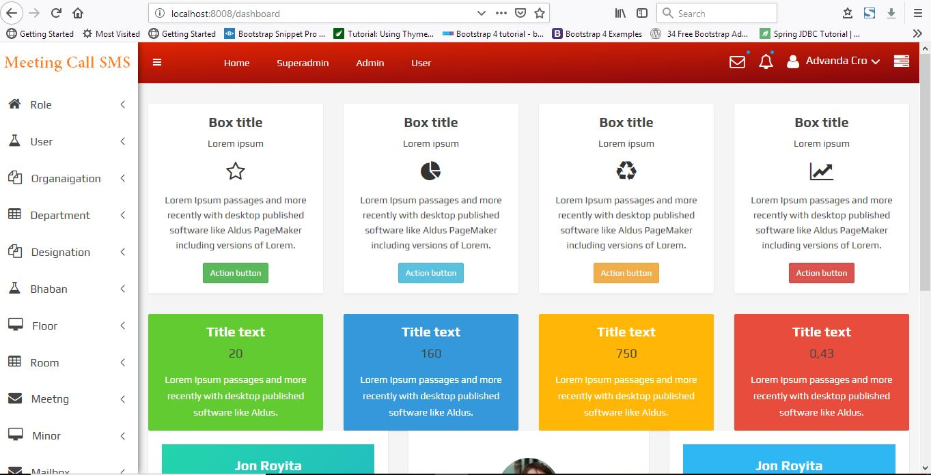
Dashboard

Slide 19
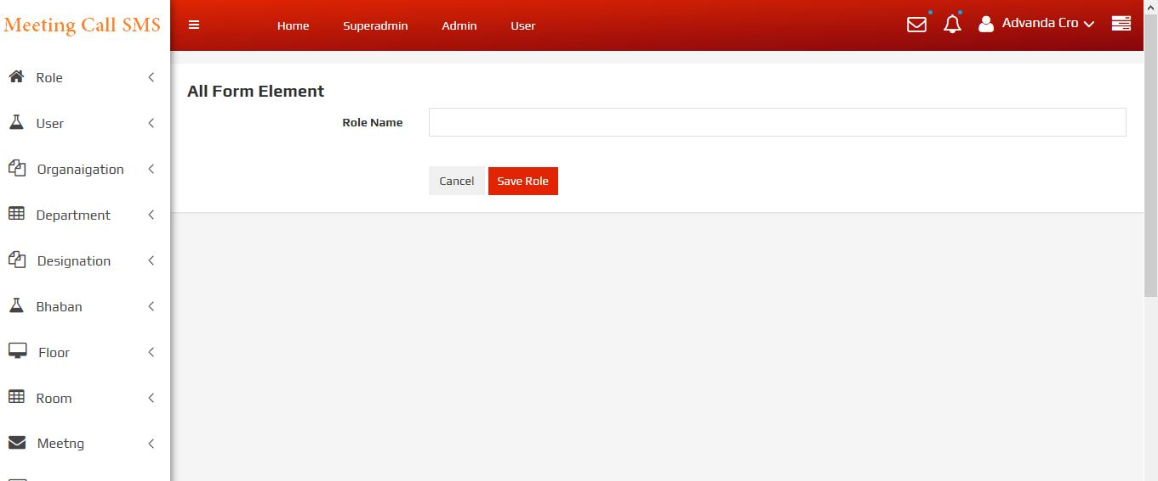
Add Role

Slide 20
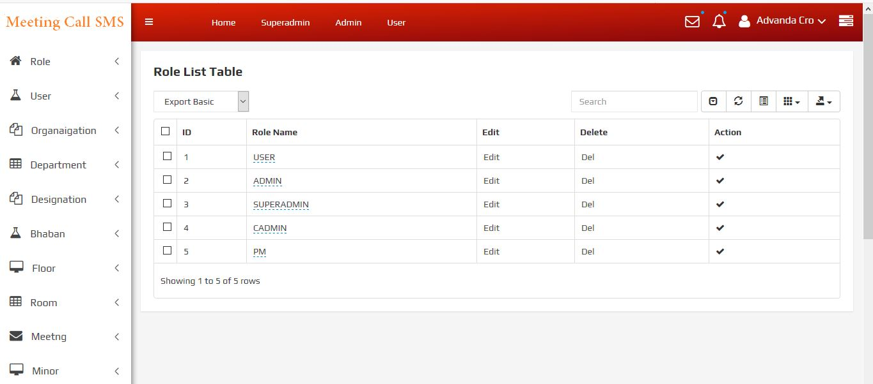
Role List

Slide 21
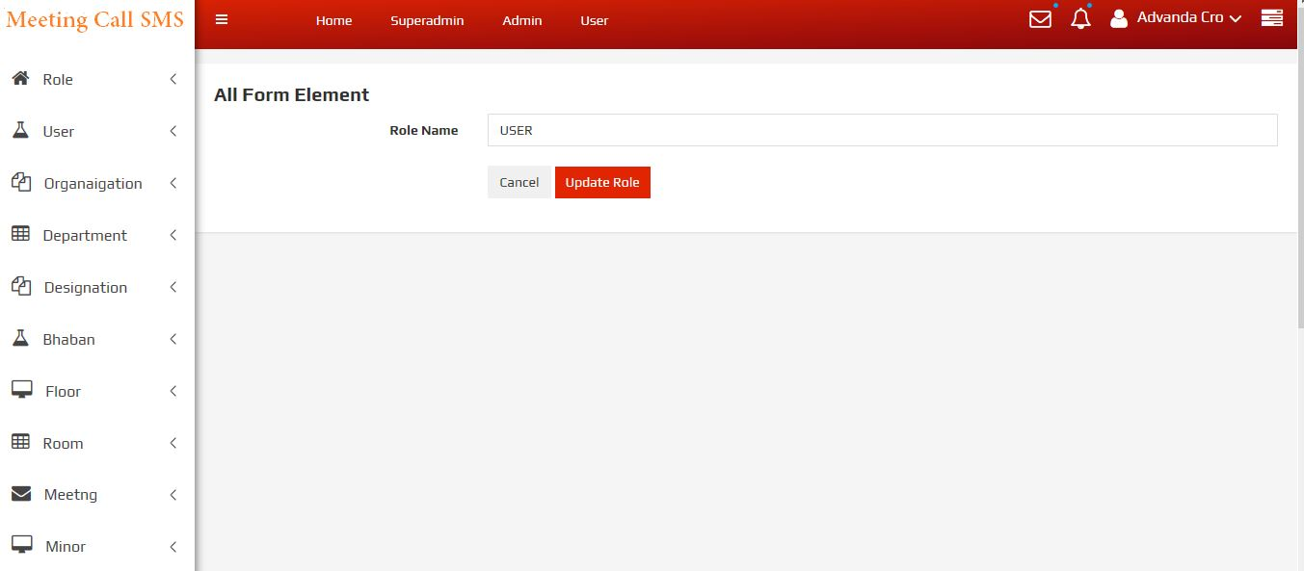
Role Edit

Slide 22
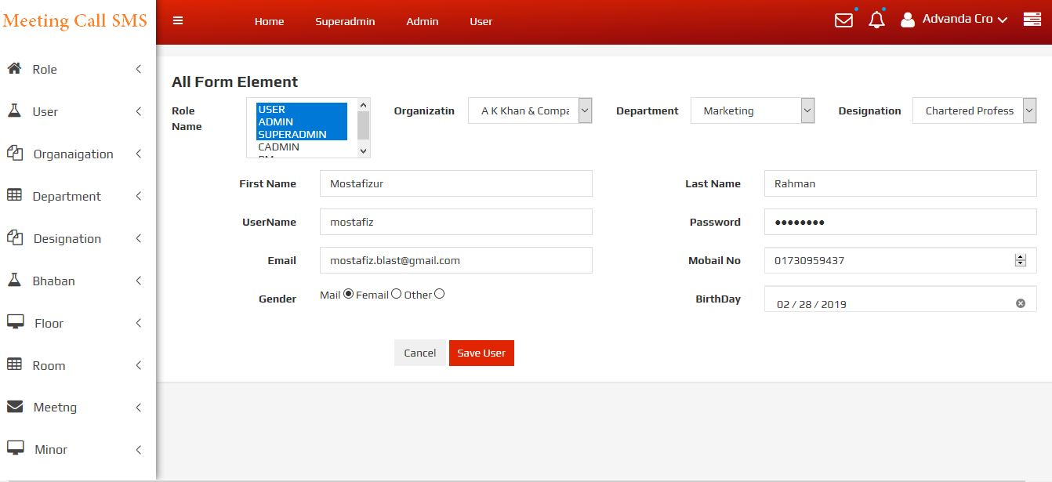
User Add

Slide 23
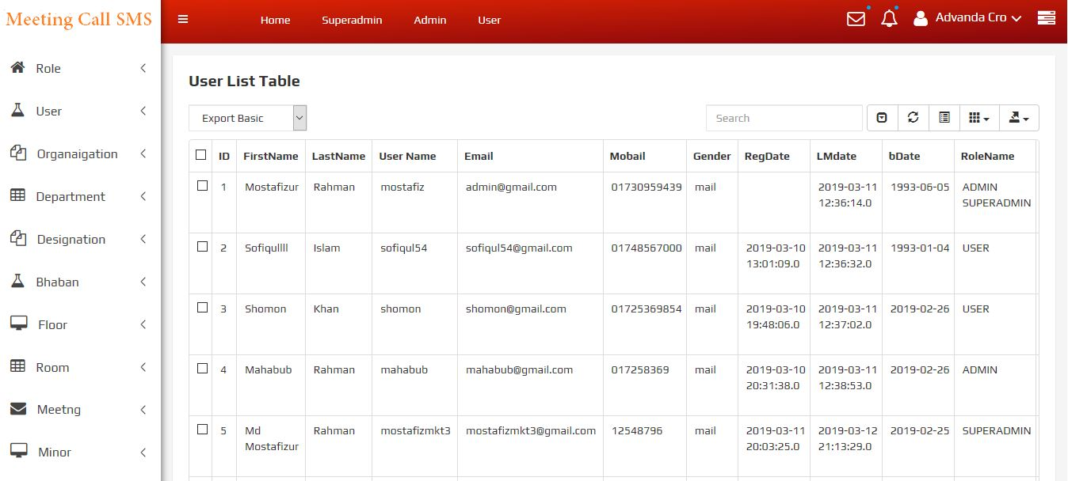
User List

Slide 24
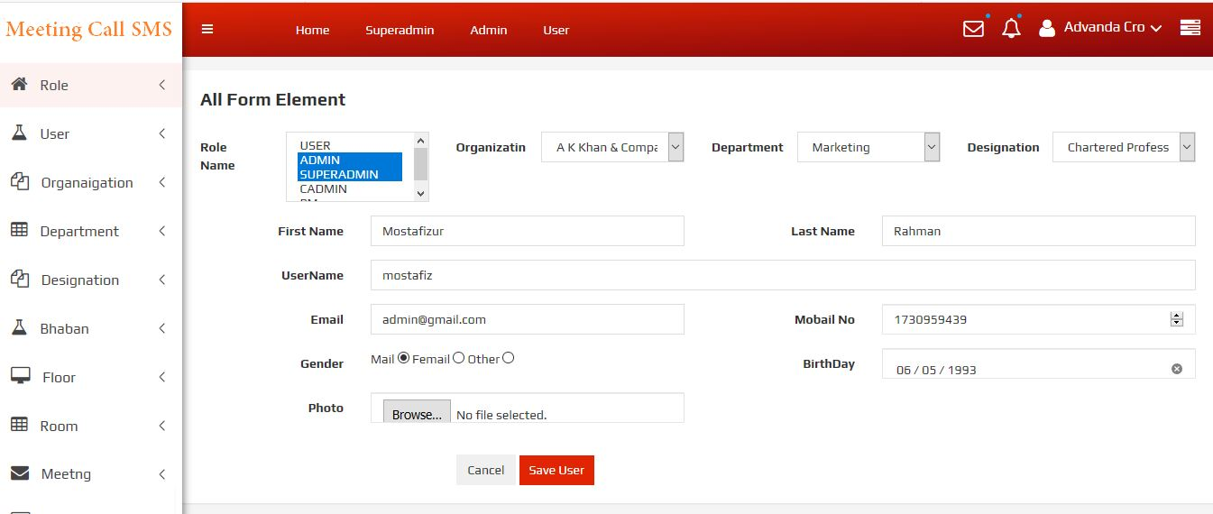
User Edit

Slide 25
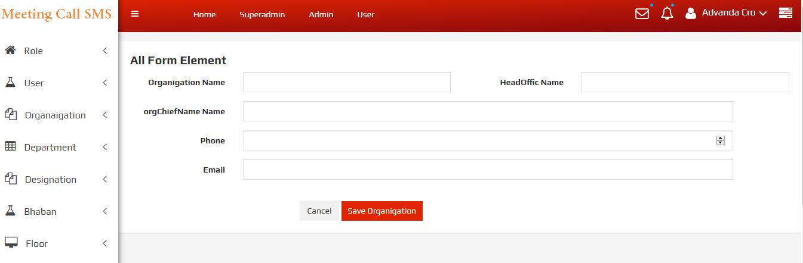
Organization Add

Slide 26
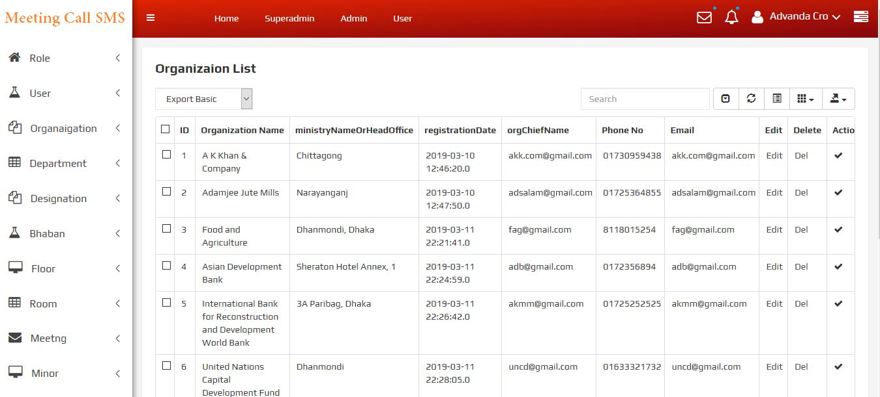
Organization List

Slide 27
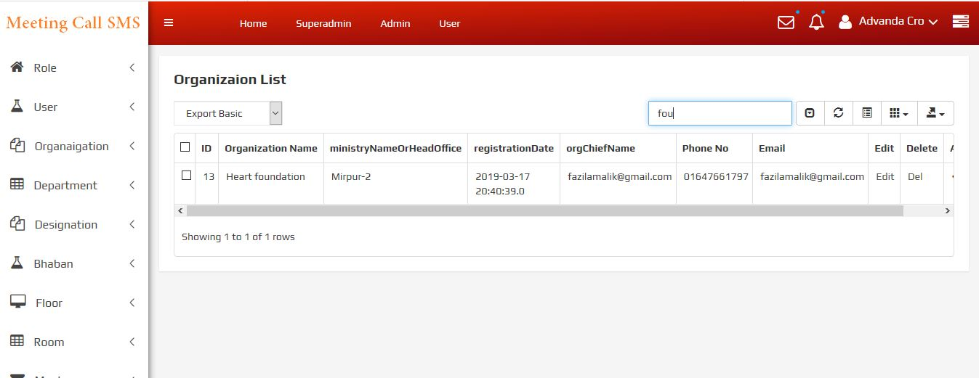
Org List Search

Slide 28
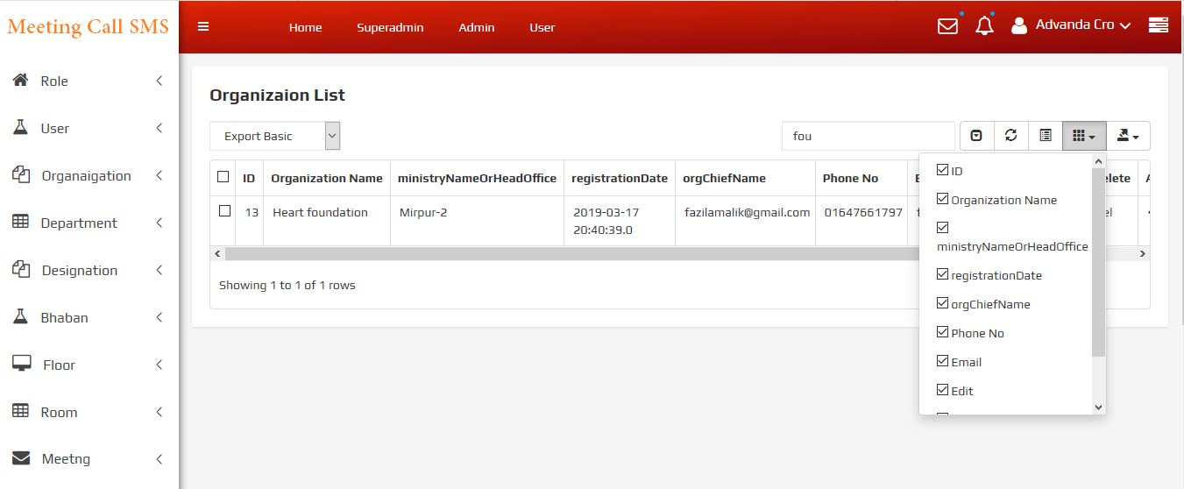
Org Active Table field

Slide 29

Information Print

Slide 30
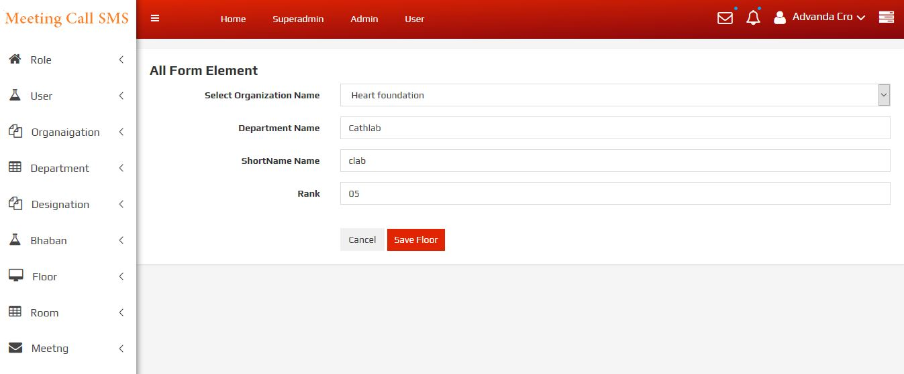
Department Add

Slide 31
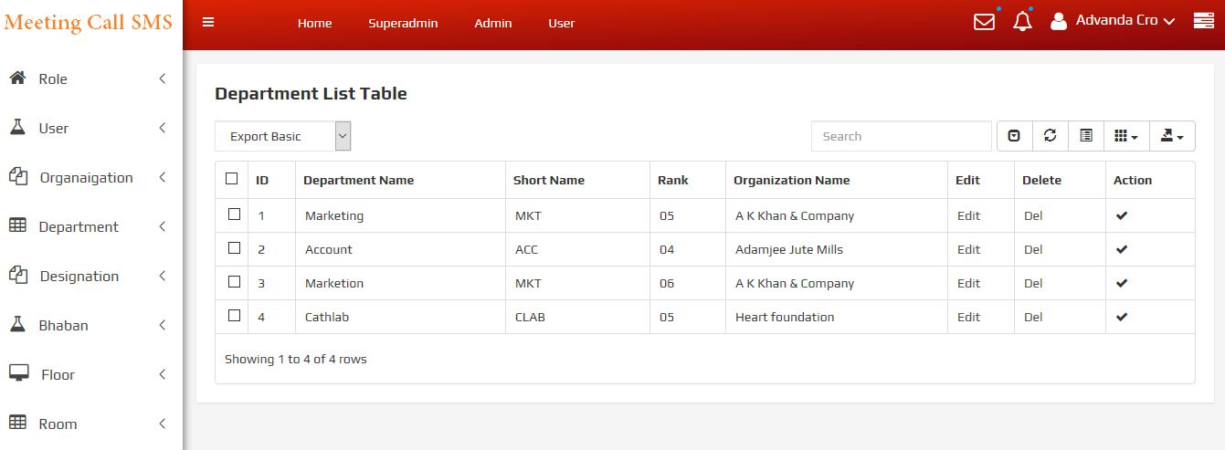
Department List

Slide 32
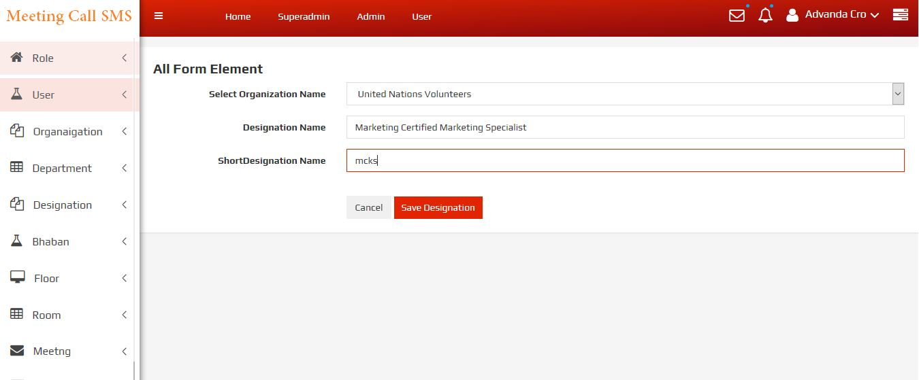
Designation Add

Slide 33
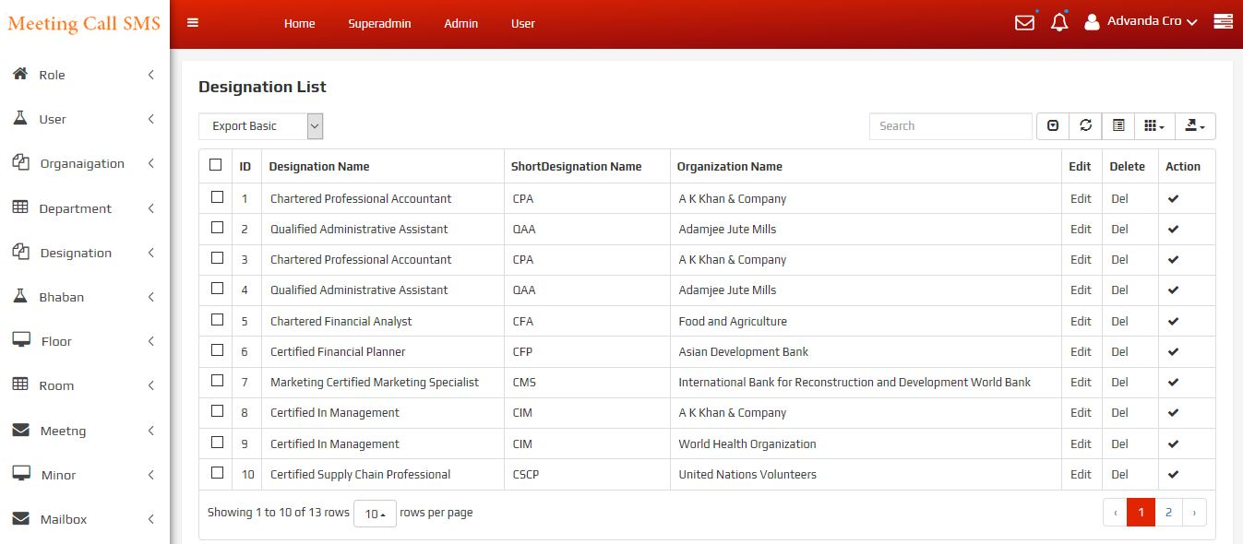
Designation List

Slide 34
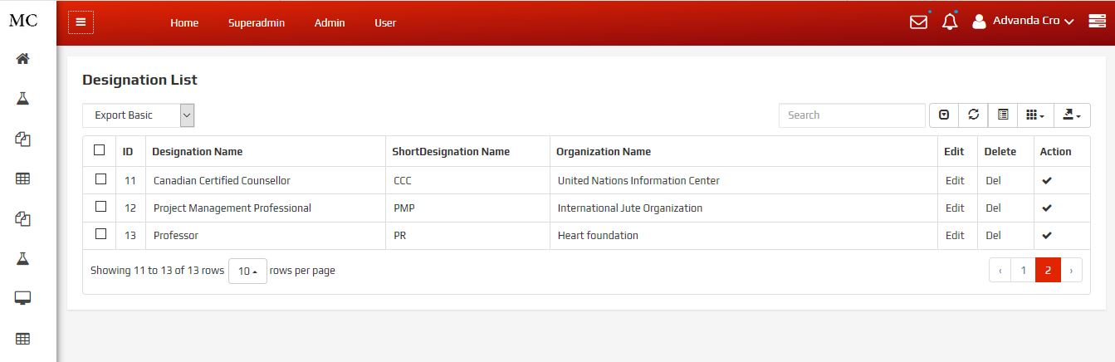
Designation Pagination

Slide 35
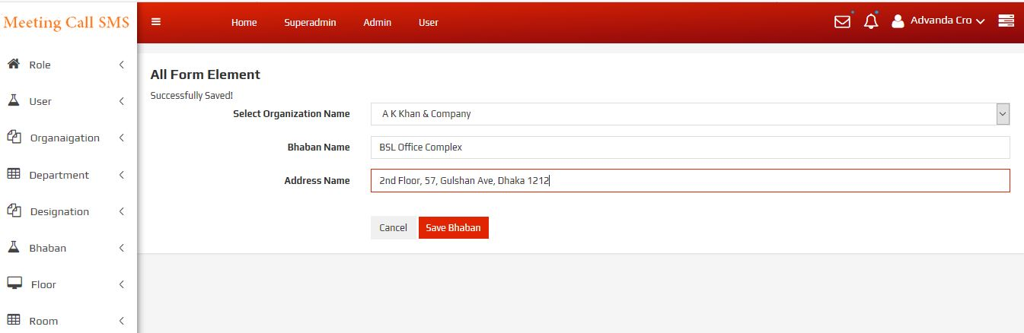
Bhaban Add

Slide 36
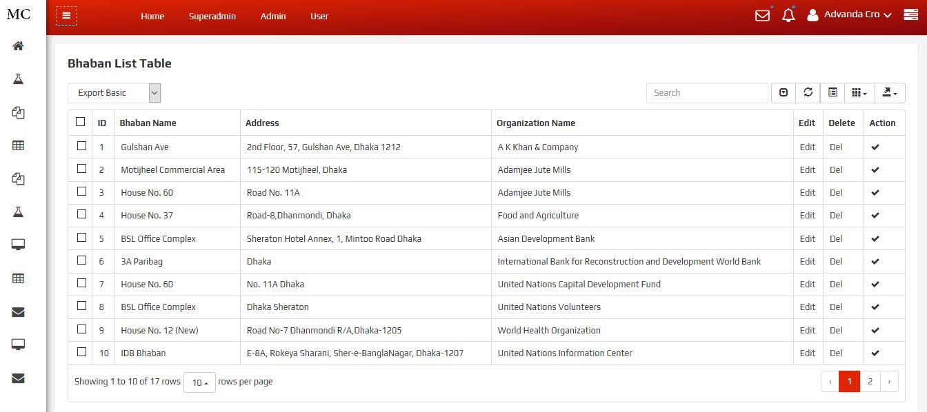
Bhaban List

Slide 37
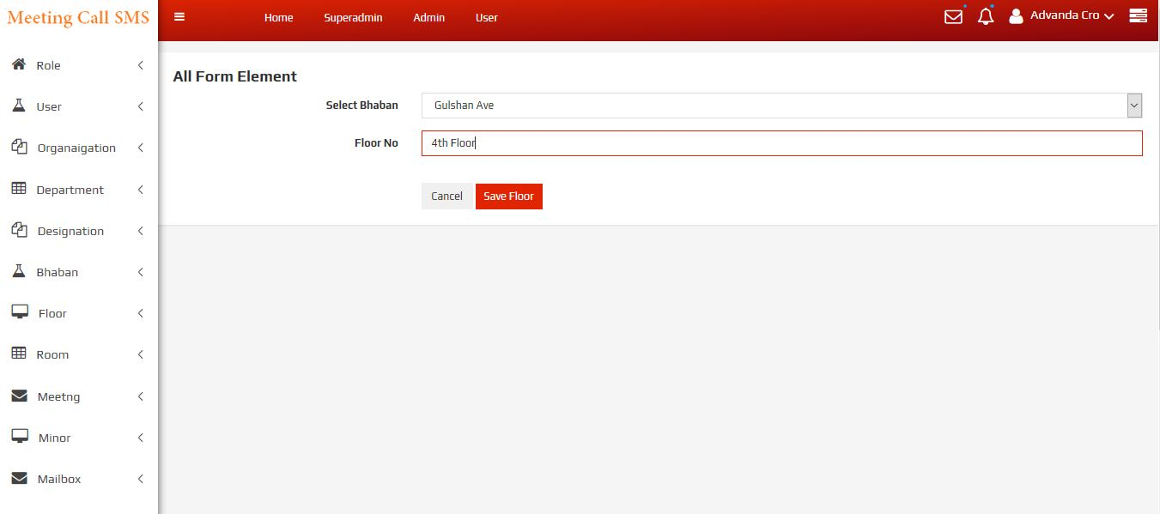
Floor Add

Slide 38
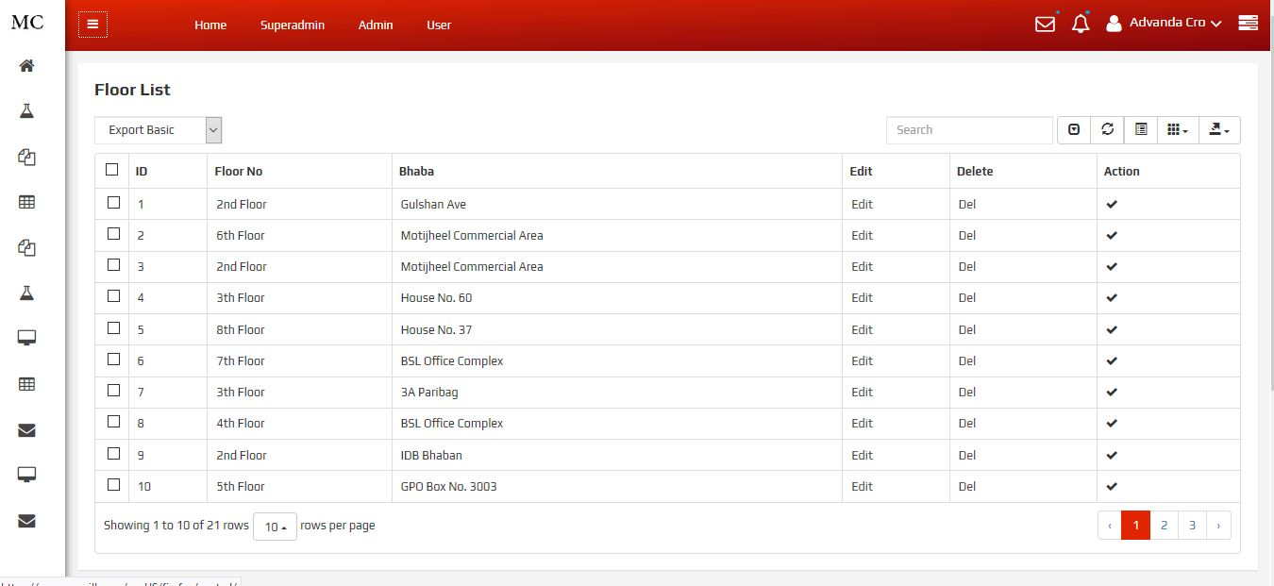
Floor List

Slide 39
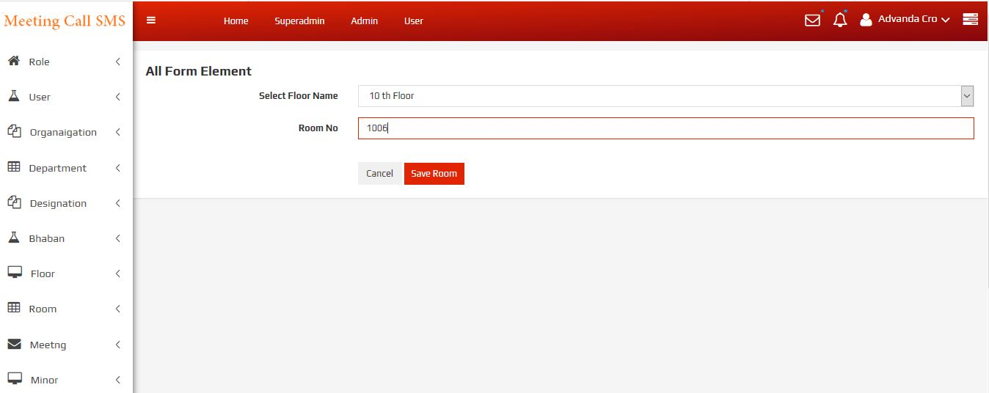
Room Add

Slide 40
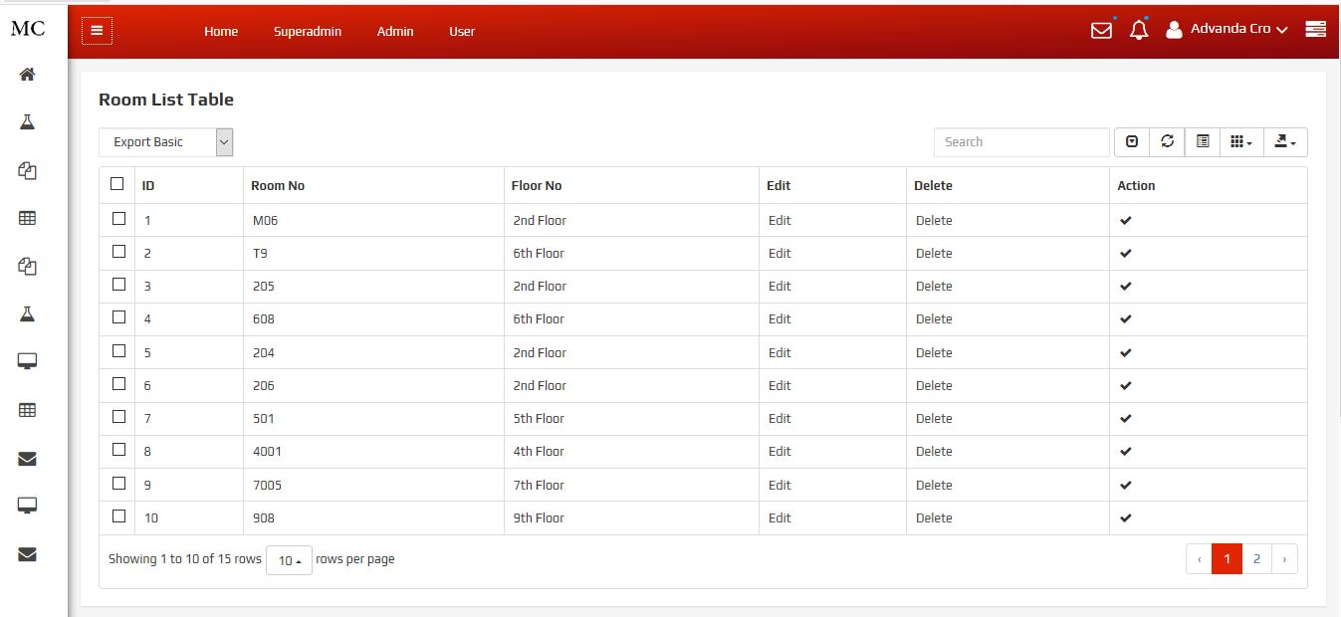
Room List

Slide 41
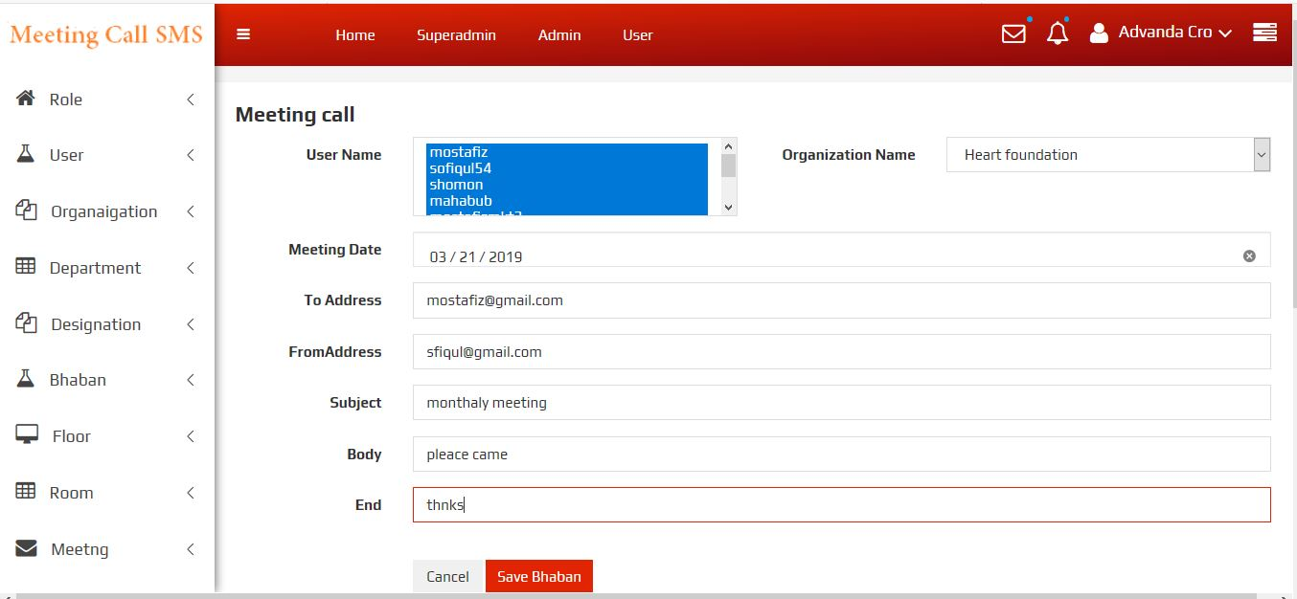
Send SMS/Meeting Call

Slide 42
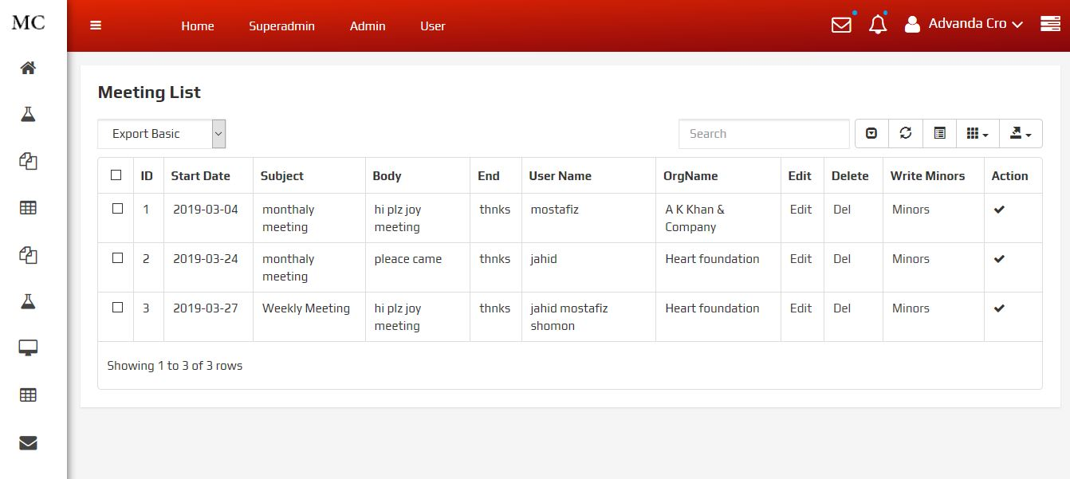
Meeting Call List

Slide 43
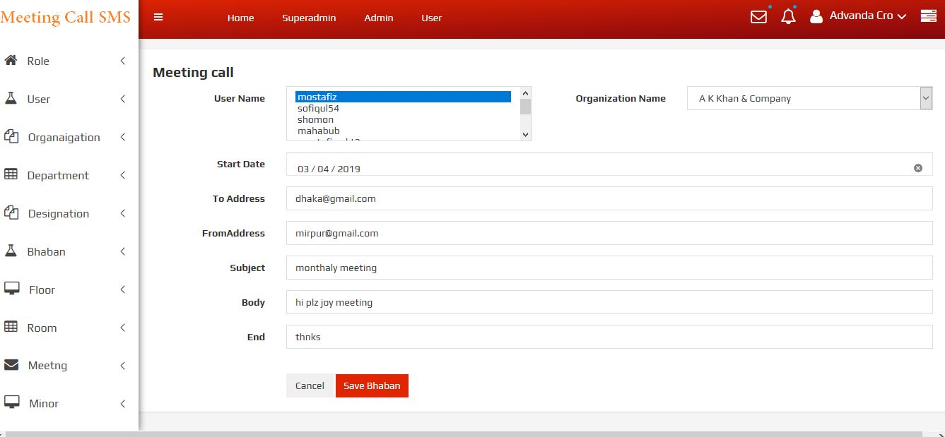
Meeting Cancel

Slide 44
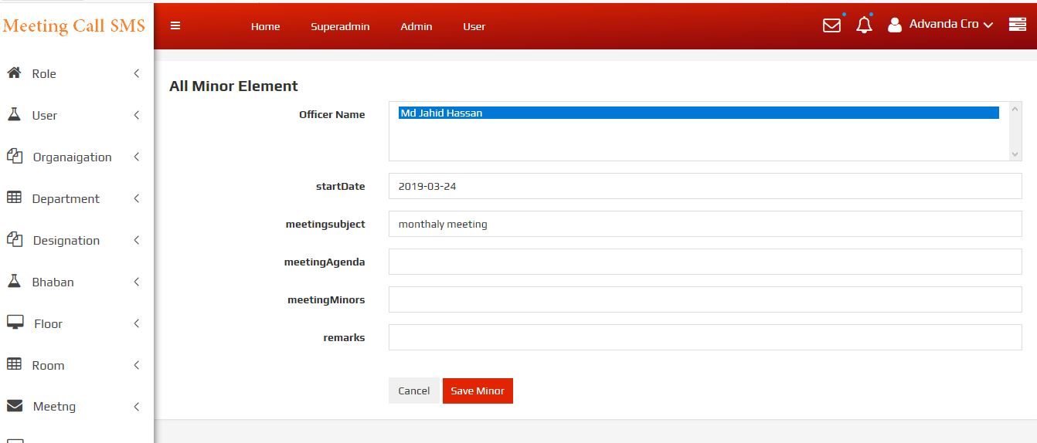
Minor Add

Slide 45
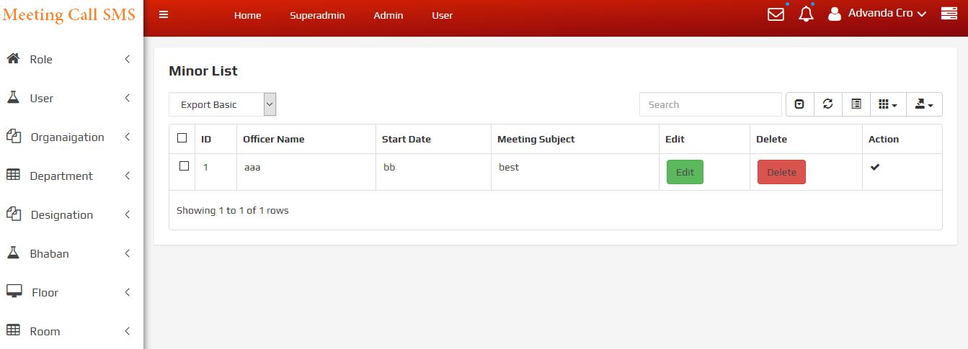
Minor List

Slide 46
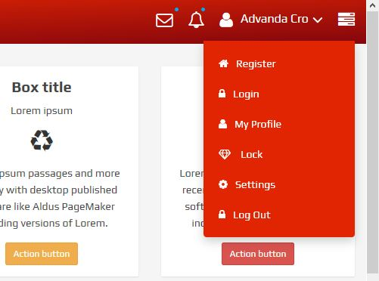
Profile

Slide 47
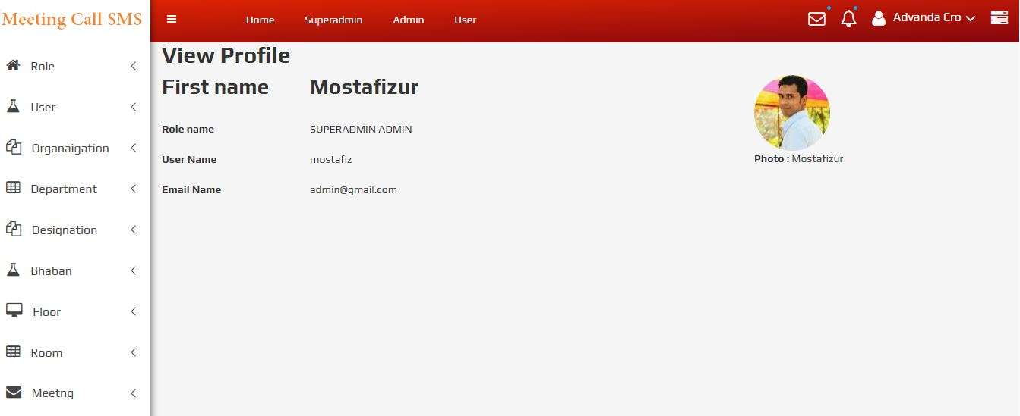
Profile View

Slide 48
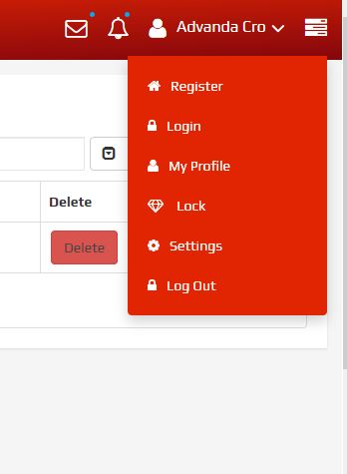
Logout Pre

Slide 49
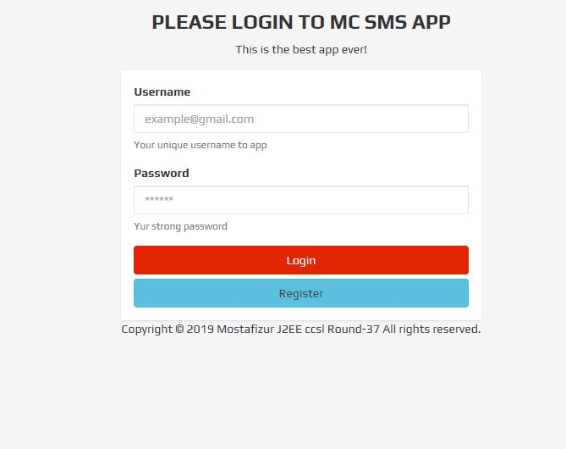
Logout

Slide 50
End of Presentation
Thank You Sir

